Slide 1
what is the mission of your work
Notes:
Good morning everyone.
I’m pretty nervous being here … I don’t feel qualified to be telling anyone what to do, but I don’t mind sharing the journey I’m on, in the hopes that it may serve you on your journey.
nothing I say is original … it was already spoken in the Word and has been better interpreted by many others since
the only thing that is new/different is our personal experience engaging with His truths.
Pray to be delivered from my fear, pride and stubbornness … deliver me from error in interpretation of Your Word and Your work.
Pray for the listeners to be able to be able to hear and discern what you want them to know through Your flawed servant whom You deeply love.

Slide 2
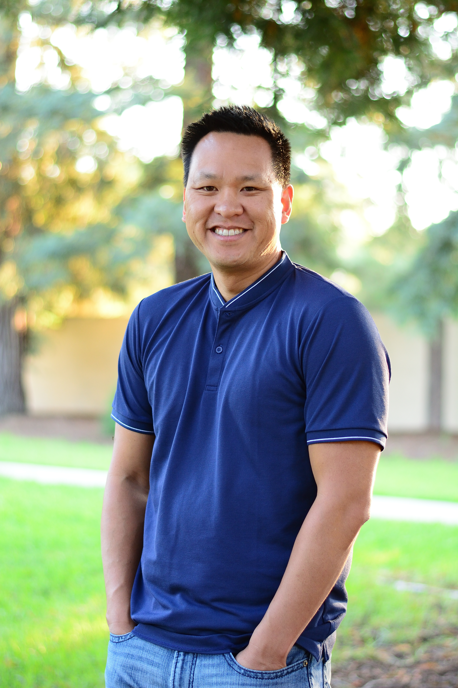
Son of Immigrants
Chinese
Bay Area Local
Brother
UC Davis “Electrical Engineer”
Consultant
Founder, Technical Leader
Startup Junkie
Notes:
My name is Steve … I’m a 2nd generation Chinese, south bay area native … I was born in Mountain View, grew up and lived in Sunnyvale, San Jose, Los Altos, Los Altos Hills and have been in Cupertino for the past 19 years. I have a younger brother and younger sister, both of whom are married and both live in the San Mateo area … not together.
I went to UC Davis and studied one of the three allowed Chinese majors … Electrical Engineering.
After graduating, I proceeded to NOT spend a single day as an electrical engineer. While in college, I loved working in and maintaining the engineering lab and would become an infrastructure and network security consultant. That was the first of many work experiences of things not going the way I thought they would.
After spending a few months at an infrastructure consultancy, the company was acquired and I got to see greed and selfishness up close. I saw the founder take all the money and run, leaving everyone behind. Granted, I had not been there long, I expected nothing, but I saw many people spend more than a decade with the company … also get nothing in return.
So like many young people, I thought I could do it better. So with 3 of my close colleagues, we hastily came up with a business plan, pitched my parents, borrowed their money and took out lines of credit in their name and started our own consulting company.

Slide 3
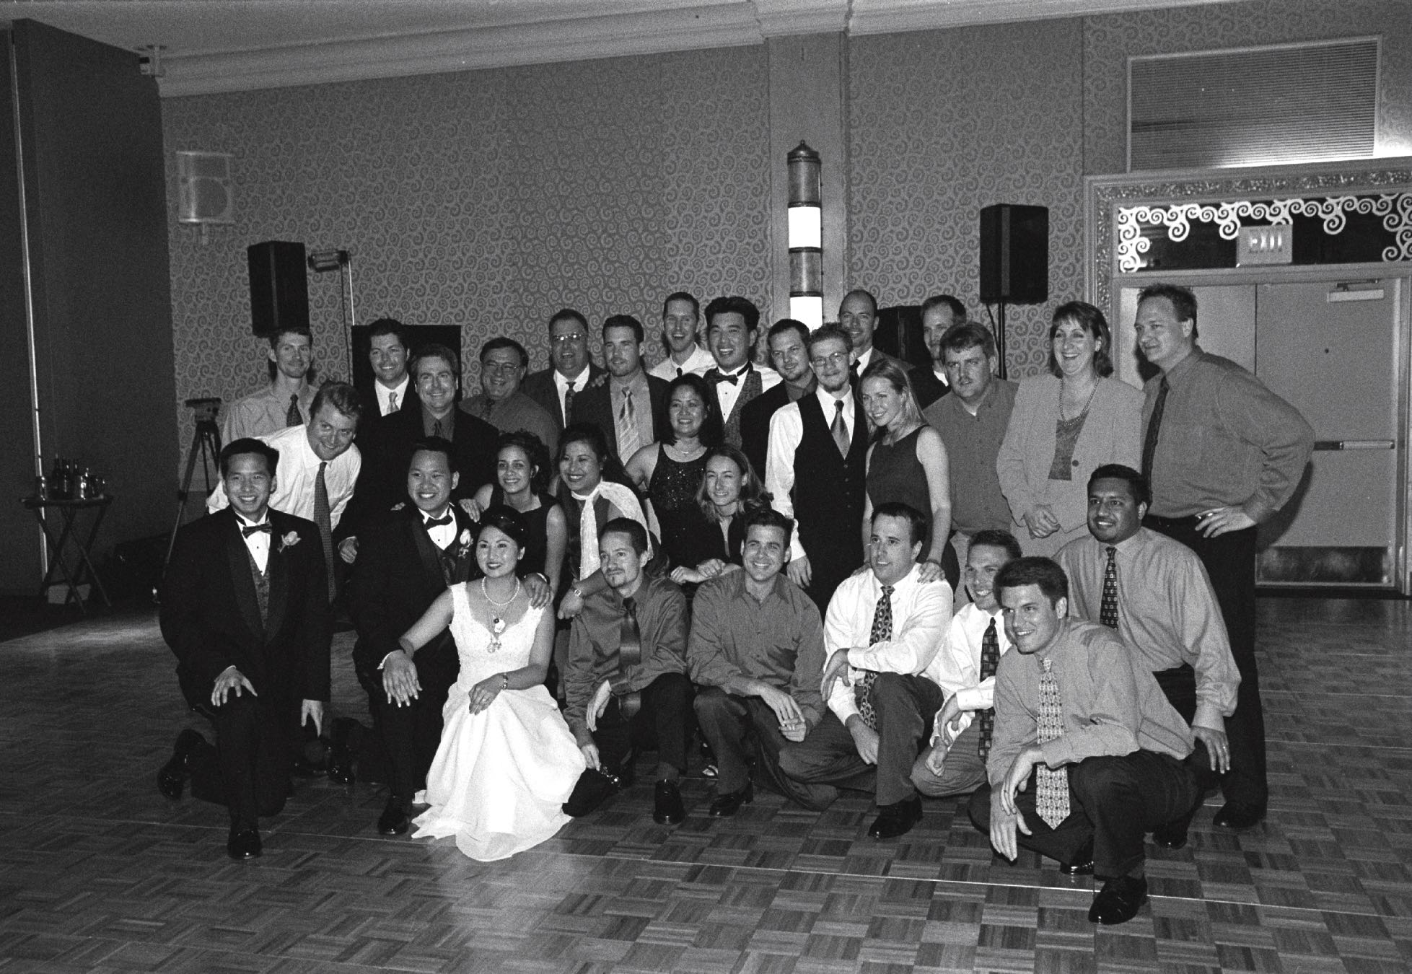
Notes:
We focused the foundation of the company around taking care of its people. We had the belief that if you take care of your people, they will take care of the customers and the customer will want to work with the company. That was our hypothesis and we set out to see if it worked.
Over the next 3 years, we grew to about 40 people during the dotcom bubble. It was a crazy time, everyone seemed like they couldn’t make a bad move … during our growth season, many of our teammates were offered DOUBLE what we could pay them, but they wouldn’t leave. We tried to push them out, but they still stayed. For all of us, it was all about the people and the relationships. We worked hard and played hard … but we genuinely cared for one another. We were a hodgepodge group … ivy league graduates, college dropouts, refugees and even a deserter from the Iraqi army … all of whom valued relationships. Everything seemed to be going great, but we started to early signs of the crash happening all around us. When all our customers had names that ended in dotcom and when they told us to cash their checks quickly, we could tell the writing on the wall.
We were trying hard to keep the team together … everyone wanted to stay together, but we were burning up our cash reserves. The 3 other cofounders and I had starting making plans for paycuts and/or layoffs, while also looking for a larger company to swallow us up and protect our extended family. We ended up selling the company with less than 2 payroll runs left, we worked with our acquirers discussing each teammate name by name to guarantee that each would have a job for at least 2 years, worked out a cash bonuses and a lucrative stock option plan for all.
It ended up being a really wonderful season in my life … but I didn’t really appreciate all that it was.

Slide 4
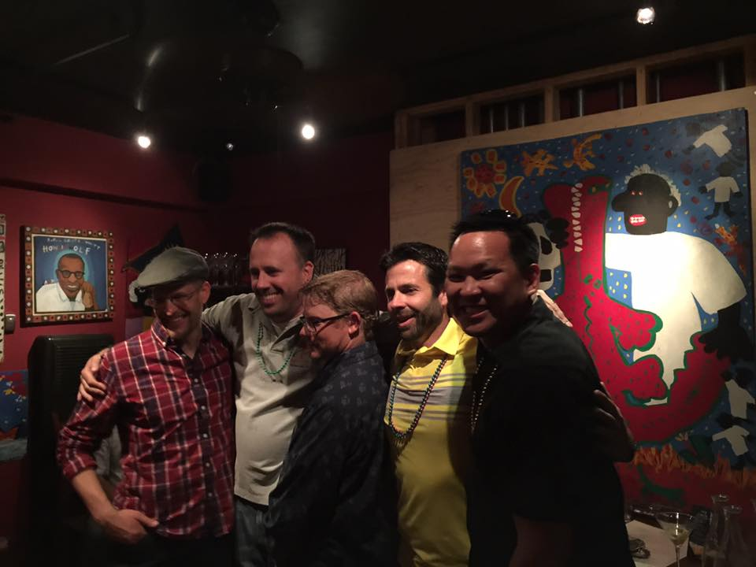
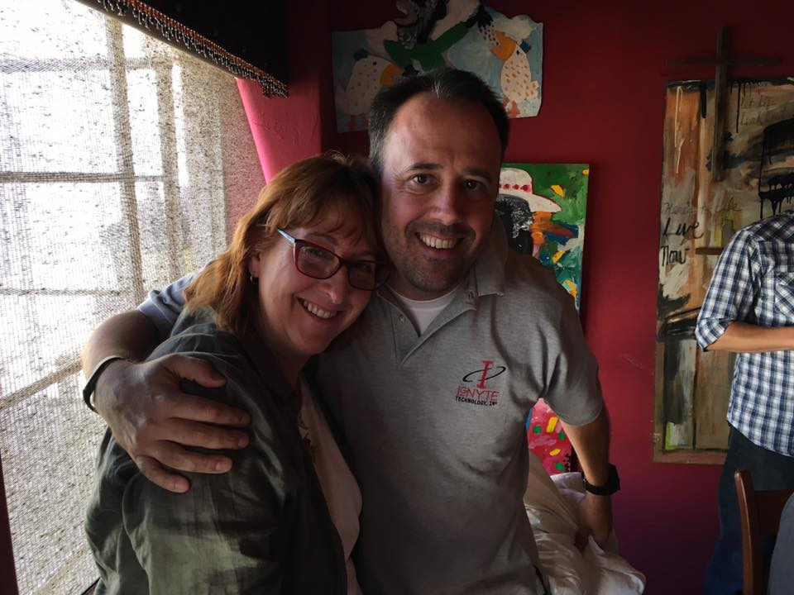
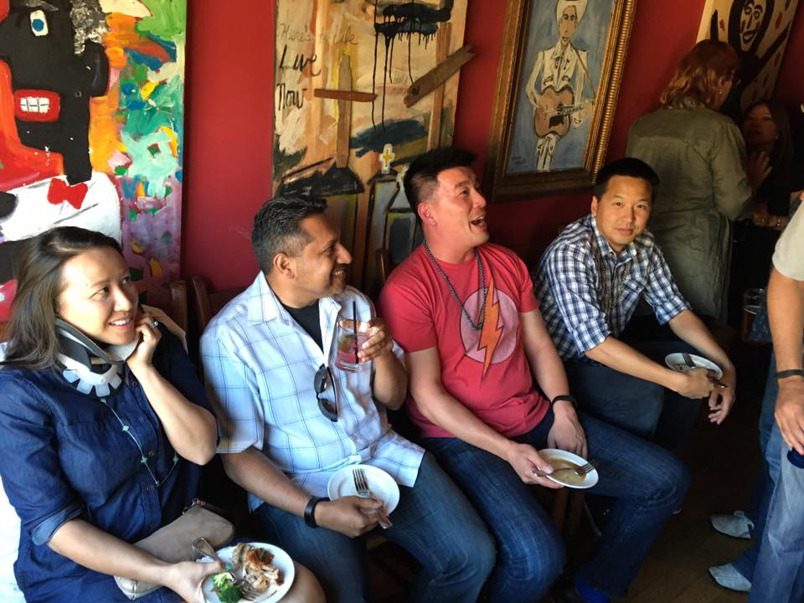
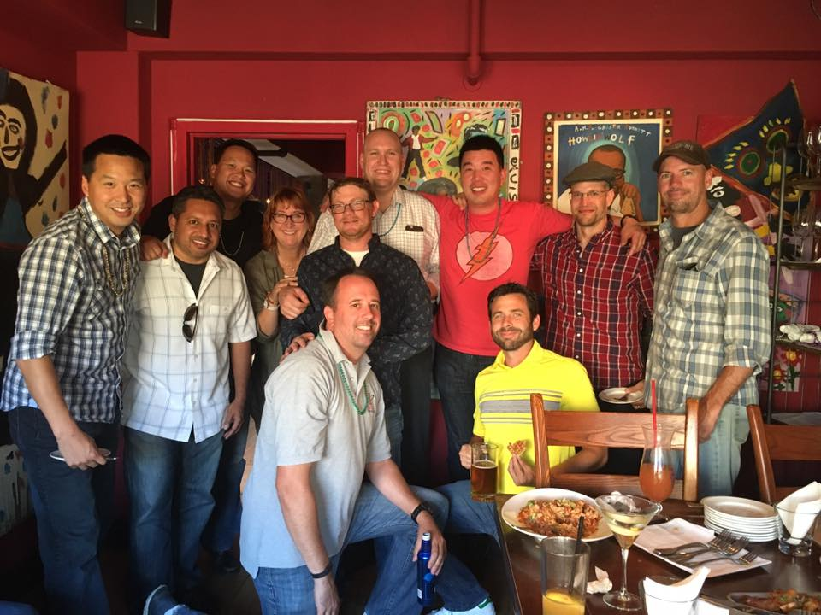
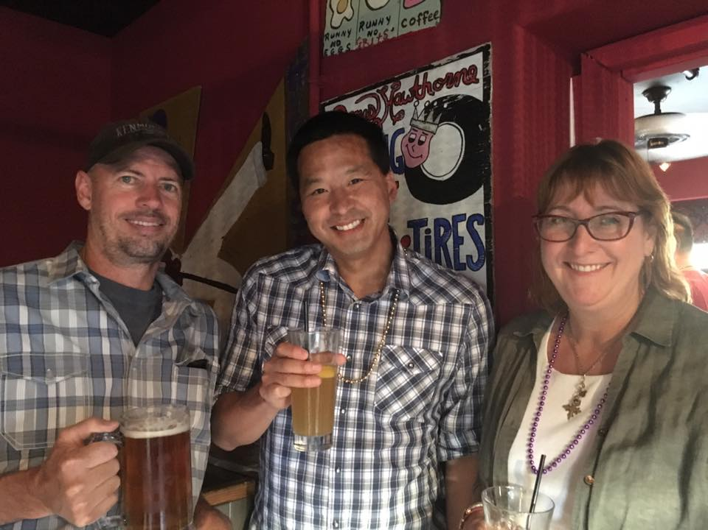
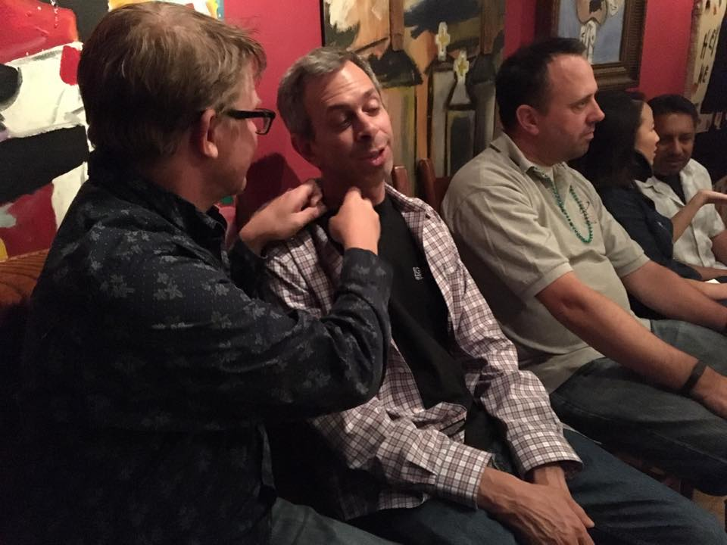
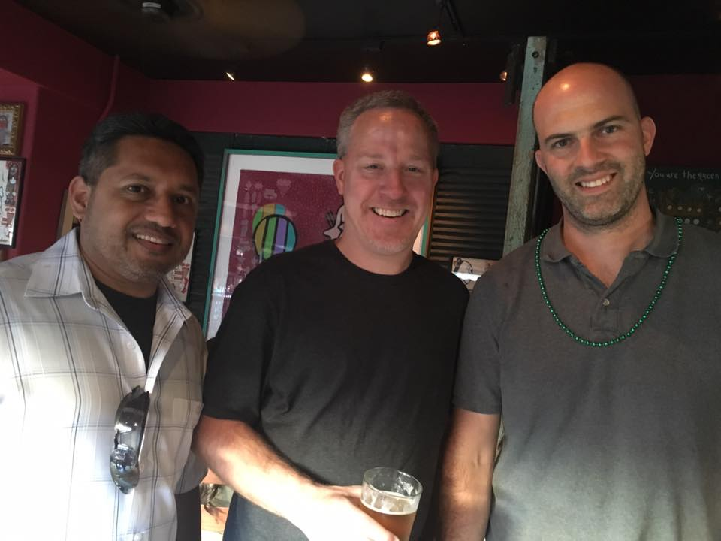
Notes:
Its been 17 years since that company was a standalone, since we worked together. Many of the folks have moved onwards and upwards in their careers, but I know we have left an indelible mark on one another … every year we still get together, last year over 30 out of the 40 showed up …
everything we built … products/services/processes … they are all outdated, obsolete and gone … the only thing that remains are the people and relationships.

Slide 5








Notes:
Since then, i’ve been a part of 8 different startups/companies, trying to do what everyone else told me to do … climb the ladder, to make more money, climb the ladder some more and make more money … while I was finding some success, I didn’t find any more happiness, it actually felt things were getting worse.
In the back of my mind I wanted to find or recreate what I had experienced at my first company, I was hungry for deeper relationships but finding very much.

Slide 6
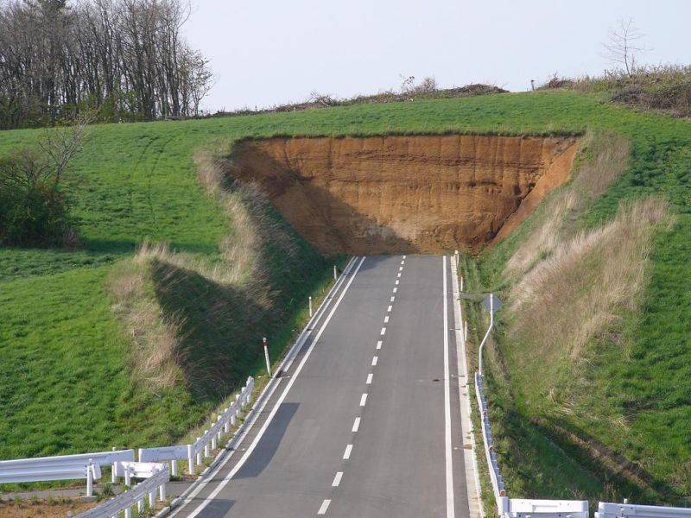
Notes:
But about 3 companies ago … I thought I was climbing well, since I was climbing fast.
I was recruited to join another startup, I made it through an interview gauntlet with the executives and their VCs and got my first VP gig at a well funded startup with some pretty good pedigree. I was pretty stoked.
3 months later, after bring in a few of my closest friends, I would resign … leaving my friends, all the stock on table and more fearfully … possibly jeopardizing my reputation since many others vouched on my behalf. I left because I realized that nothing was really there, no real product, market fit or even market … it was really obvious, but I didn’t want to see it. Why? Because I wanted to feed my ego … I wanted title, the options, the money and all that I thought it would bring … independence and self-reliance. I would be a “small god”.
I knew I had the wrong perspective and/or the wrong definition of things … and then set to make decisions based on a false foundation.
I would spend the next 6 months, going through the Word, listening to sermons, reading tons of books and spending the time to think about how I had gotten here. I would take the time to wrestle with God about my fear and to call out my pride … then succumbing and submitting happily to God’s grace.

Slide 7

Notes:
The first question I had to answer is Who am I? What was my identity? It was of vital importance, If you know who you are, you know what you need to do.
When I was younger, I identified myself as a teenager, so I rebelled.
When I was a college student, I studied a bit and partied a little more.
When I was a graduate, I got a job and I worked.
During this time is when my identity became tightly wound with my work and its success or career progression … and when that definition changed or I didn’t hit the expectation … there was always an identity crisis … maybe this isn’t for me, maybe I need to be doing something else or maybe I just need to change industries. I took a good thing and made it a God-thing (my idol).
Up to the point of my sabbatical, I had always prioritized the identity as defined by the world over identity I was told in church. I started to understand I had completely missed it. Instead of ask “Who am I?” and answering it myself it had to become “Who does God say I am? When I know that, then I know what I need to be doing.
I am an image bearer of God. I am eternal, precious, loved, provided for, adopted and being refined for an eternity with Him.
I am a follower of Christ, and therefore all work I do is spiritual work, just as those in full time ministry, because of how I am called to live my life.
I am suppose to represent Jesus Christ where ever I go or am called to.
I am called to participate in His work.
I have been placed among other image bearers of God … All those around me, the believer and nonbeliever are also image bearers of God. Do i see it and do I treat others in that light?

Slide 8

Ecclesiastes 3:12-13
Ecclesiastes 5:18
Notes:
When I looked up work in the Bible, I wasn’t finding much … it wasn’t until work was connected to “labor”, that I found there was plenty spoken about it. Being in tech, I never thought what I did was “labor”
When I lean on two truths … God is all powerful. God is good. Things are not an accident, they didn’t slip by God’s awareness, so we can see everything is for our Good and His glory.
- Work is a gift from God (ECL3:12-13) … it is good, because it is given by God
- He gives us our portion - ECL 5:18
Prior to our fall, we had work to do (genesis 2) - we were to tend to the garden.
After our fall, (genesis 3) - we had work to do to, but now it would be hard and it would be wasted, squandered, stolen, perishable and non-eternal.
I have a conflicted relationship with work because of my sin nature … I desired to be just like God (in control) and because of my sin the work is hard and its byproducts are not not lasting and not in our control
I used to have this dream (let me know if you have the same fantasy), when I am financially set, I will retire and go into full time service to the Lord … but there is a reality, that if I don’t start to do it now, how likely is it to happen later?
What has now become clear to me … My vocation is the pulpit God has assigned to me. Given my identity in Him, then I am to represent Him here.
I believe that it is important to know what is the biblical perspective on labor/work/vocation? There are 4 concepts that have helped me to better understand and to approach my vocation.

Slide 9
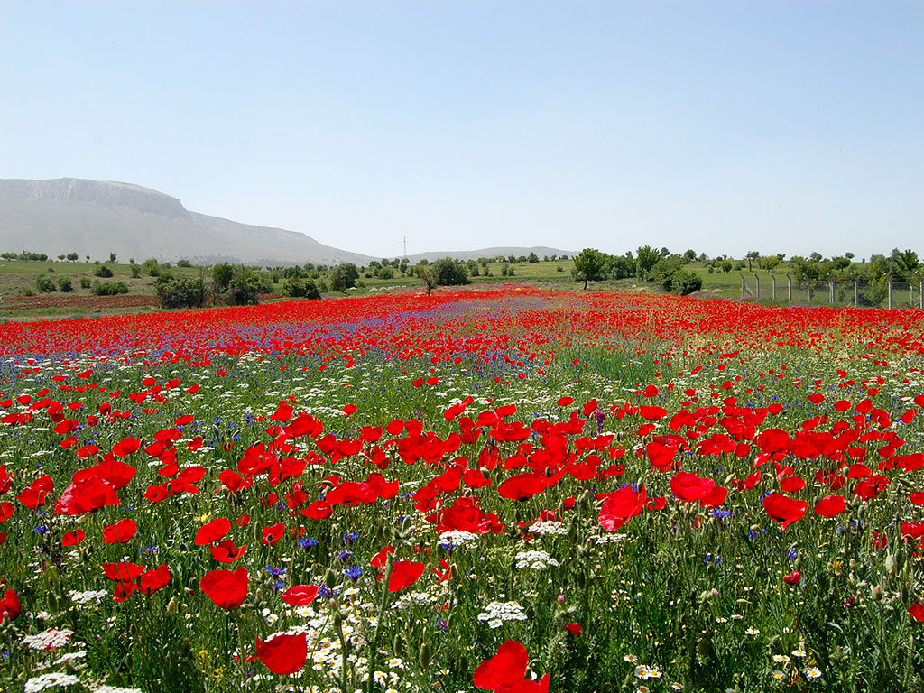
number 1
I do not work to earn a living … God Provides
    Matthew 6:25
    Philippians 4:19
Notes:
You do not work to earn a living … God provides (Matt 6:25)
This goes against everything I know … I am working, I am earning … I’m trying to earn little more than I need, so I can provide for the future (toys, gadgets, college, travel, retirement …). But when I dig a little deeper, I see that it is God who put me into the family I was born into, He gave me my environment, my experiences, my skills, my talents and the opportunities.
In this world, there are people and there are things.
If I go into the marketplace with the primary purpose to earn a living … when I am not earning what i think I should, I will end up using people to get to my goal.
If I am called to be a witness and to serve those around me … THIS CANNOT WORK. I cannot use people and serve them simultaneously. They are mutually exclusive to one another, so there can be only one solution … God provides and therefore I can serve.

Slide 10

number 2
There is no relationship between how hard I work and what I get … God Decides
    Deut 28:38
    Deut 8:17-18
    1 Cor. 4
Notes:
There is no correlation between how hard you work and how much you get (Deut 8:17-18) (1 Cor. 4:) … God Decides
At most of the startups I worked at … I was a sales engineer. I had a quota, an area of operation and a compensation plan. On the surface it seemed quite clear, that if I worked and I achieved the goals, I got what was promised on the comp plan. If I could crush 150% of quota, I would get 300% of my variable pay.
I have to dig a little deeper and it takes a lot more effort to overcome my ego and pride … If I was completely honest, I know that there were deals that came out of nowhere, that became a lot more than expected, that just happened, just as there we’re “sure deals” that would disappear the next day. In all those scenarios, I would work as hard as I could, but the results were out of my control. I heard someone say, that man throws the dice, but God picks the numbers … I believe it now.
When I forget that God Decides what I get, I WILL ALLOW the marketplace will dictate my commitment to God. It sounds strange, but follow me for a bit … if I have a goal to make certain amount or to get a certain title, when I do not get it … I will ignore my priorities list … it always starts of a little more subtly, staying longer at the office, bringing the work home, make different moves, occupying my free thoughts and I will not pay attention to the things that are right in front of me (wife, family, friends …).
If God Decides, then I can work in collaboration with God, He share with me what should be the priorities and then I can invest accordingly the time, energy and other resources I’ve been given.

Slide 11
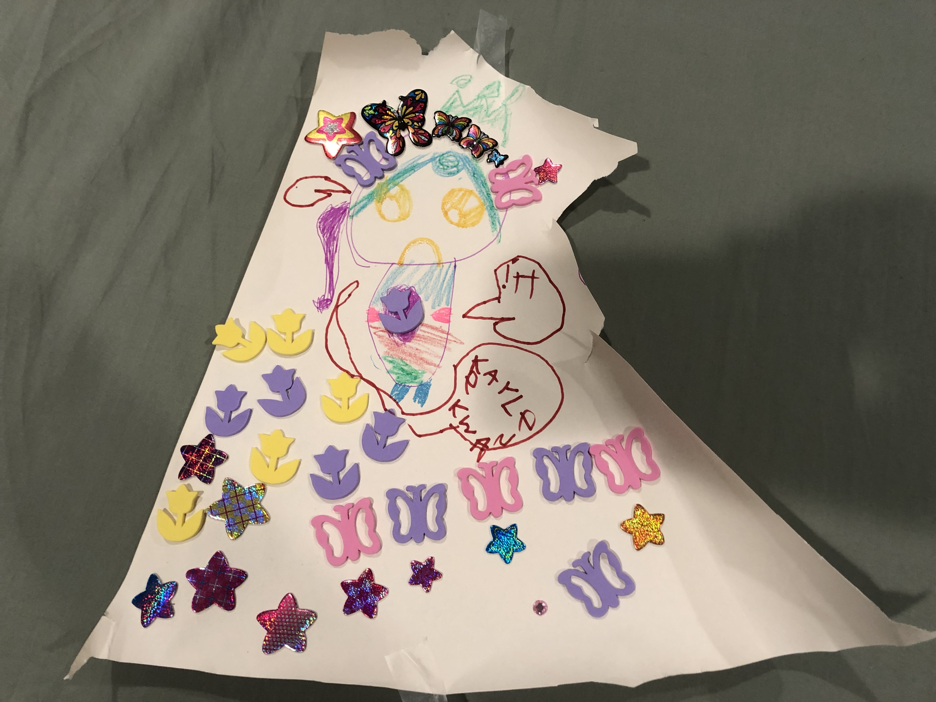
number 3
There is no intrinsic value for the byproduct of my work …God Loves Us
    2 Peter 3:10
    1 Corinthians 3:12
    Philippians 3:4
Notes:
There is no intrinsic value for the byproduct of my work (2 Pet 3:10, 1 Cor 3:12, Phil 3:4) … God Loves Us
I’ve come to know this is true by simply letting little time pass between companies. Whatever amazing product/service we discovered or built, it is obsolete or just plain useless within a few years. When I apply God’s Word, that it will all be burned.
My six year old, Kaylee … will spend a few hours on a drawing and when I get home, she is an explosion of excitement and story. She will explain to me all the explicit details and I will be fully immersed into her story and ask her questions and listen intently to her response. And this piece of art, will eventually make its way to same place of honor that my childhood drawings did … the refrigerator door, the wall in the hallway or onto my nightstand so I can look at it every day. If I go to the a local art gallery, garage sale or even ebay/craigslist … how much do you think I can sell this drawing for? Nothing.
There is value in Kaylee’s drawing only because I love her. Our father who is in heaven, values our labor because He loves us, not because of what our labor produces.
When I forget that there is no value in the byproduct of my work, I will work for the temporal instead of the eternal. I will also see my vocation as my source of fulfillment. I have noticed that our society places value and high esteem in the pursuit of “self-discovery”, “self-fulfillment” and “self-actualization” … My fulfillment is suppose to come the Lord, where we are asked to “die to self” and take up His cross. I do not want to miss the work He sets before me, for the growth or experience He sees fit for me.

Slide 12
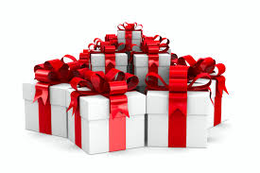
number 4
There is nothing I can contribute to the work of God … God is Generous
    Hebrews 4:3-4
    Isaiah 46:9-10
    Psalms 115:3
    Ester 4:13-14
    Matthew 16:18
Notes:
I can do nothing to contribute to the work of God (Heb 4:3-4, Isiah 46:9-10, Matt 16:18)… God is generous
This was incredibly freeing, no matter what the results of my work, His perfect plan will carry on. With this, I was able to see work for what it is … it is a joy … it is an open invitation in the participation in His work, for my good and His glory … I get to witness and experience His generosity. He loves us so much that He wants to shares it with us.
Since I come from the startup world, I’ll offer this example:
Let’s say the greatest investor/VC with a perfect record with amazing investments, s/he comes to me … Hey Steve … have I got a deal for you, its the best deal I have ever seen … if you invest $10,000 with me … I’ll guarantee you’ll get $100M at the end of this deal and to alleviate any fear you may have, I’ll also guarantee you won’t lose a penny of $10,000 investment. But before you invest, I just want to also make it clear to you that you aren’t really needed to make this deal work, I’m only offering you this deal because I’ve known you for a long time and I really like you … so what do you way, do you want to in? So I scramble to raise the money, give up some starbucks lattes, lessen the number of amazon deliveries, perhaps even give up my netflix subscription. A few months later, s/he comes to me with a check for $100M … I respond, wow, aren’t you glad I was part of the deal?
Instead of gratitude, I respond with pride … because I lost perspective. I thought I was needed for this to work.
If I miss the fact that I CANNOT add to God’s work … If I believe that I can contribute to His plan, I will eventually justify breaking His commandments to contribute. I will be prioritizing my efforts/contributions and sacrifice the people around me to try to add to God’s work.

Slide 13
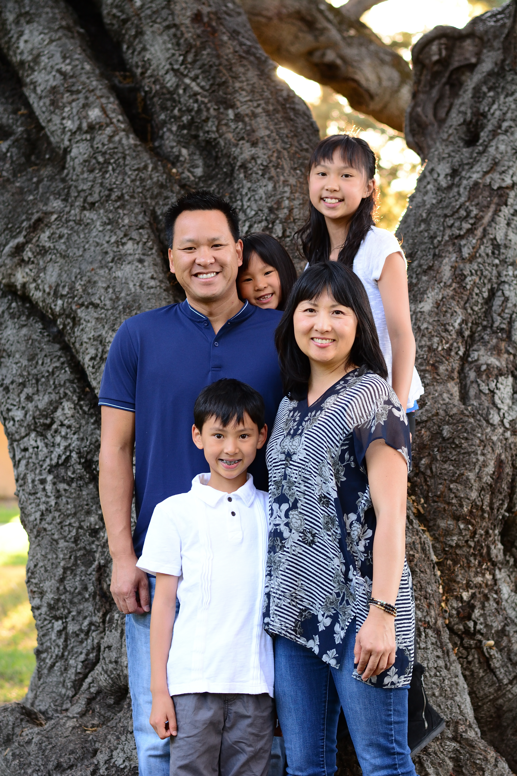
an image bearer of God
a beloved and adopted child
a husband
a father
a steward of His resources
one of the shepherd of His flock
Notes:
I am grateful to our Lord, He has softened my heart and loosen my stiff neck to be able to embrace the identity He has declared for me.
He has also clarified my mission for this season:
for my wife to prosper
for my children to be loved and for them to know the Lord’s love through our interactions
be mindful for the time, finances and opportunities He has given
to care for all those who He brings before me
I feel that when I’m in proper alignment in action and attitude, this become becomes easier … its not to say things are easy, but they flow in a way that builds its own momentum and encouragement.
When I have it slightly out of whack, things can become laborious, a burden and sucks the energy out of me.

Slide 14
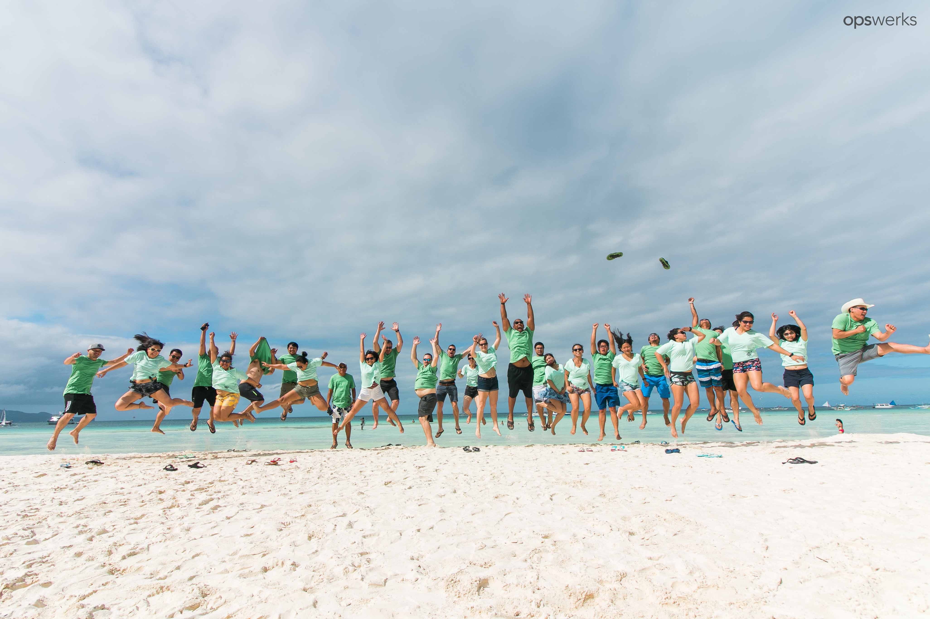
To help those next to us and in front of us live better lives through
Building Healthy Community
Continuous Self-Improvement
Gratitude in Every Encounter
Compassion in Action
Generosity to All
Choosing Positivity
Looking for Hope
Notes:
Three years ago I founded another company with the mission and methods you see (many of its tenets has its roots from Scriptures). I’ve got to witness and participate in the growth of many brothers and sisters. Some are believers and we help keep each other encouraged and accountable and for our non-believers, we simply strive to show them God’s love for them in our words and actions. That a seed may be planted, that we nurture the growth already there, so that He may harvest when He deems it is time. I have found that there is always a need, we were designed for relationship with the Lord.
The team has adopted the mindset and are coming up with their own expressions of our methods and practices it amongst each other.
Our mission and methods were put together 7 years ago … during that time with the Lord.
I know that this will have its own season, but I am able to better appreciate, cherish and steward the time with these people because of the clarity He has provided … that my vocation is my pulpit and that I’m to love and to serve God to and through the other image bearers He sends my way.

Slide 15
the cliff notes
Remember:
    God Provides
    God Decides
    God Loves Us
    God is Generous
Then Ask the Lord:
    Who do you say I am?
    What is the mission for this season?
    How do you want my heart to receive?
    What will you give me in exchange for my fears, concerns, hard heartedness and stubbornness?
Notes:
Remember:
God Provides
God Decides
God Loves Us
God is Generous
Ask the Lord
Who am I?
What is my mission for this season?
How should my heart receive?
What will you give me in exchange for my fears and concerns?

